Slide 1
Introduction to the C Programming Language

Slide 2
On Today’s Show…
The C programming language
Syntax
Variables
Conditions
Control structures
Arrays
Preprocessor
main()
Visual Studio demonstration

Slide 3
What Is C?
Developed by Dennis Ritchie in 1970’s (after B), last version published in 2011
Widely used today
Influenced many of the modern programming languages
C++, Java, C#, Python, etc.
“C is quirky, flawed, and an enormous success” – Dennis Ritchie, “The Development of the C Language”

Slide 4
C vs. other languages ?
Low Level
Talk to hardware
Manipulate memory
Control exactly what happens when it happens (vs. e.g. garbage collection)
Unlike languages like Java & Python, C is compiled directly to machine language
Not the first choice for GUI/Web applications
Embedded application
Compact code size
Real-Time performance

Slide 5
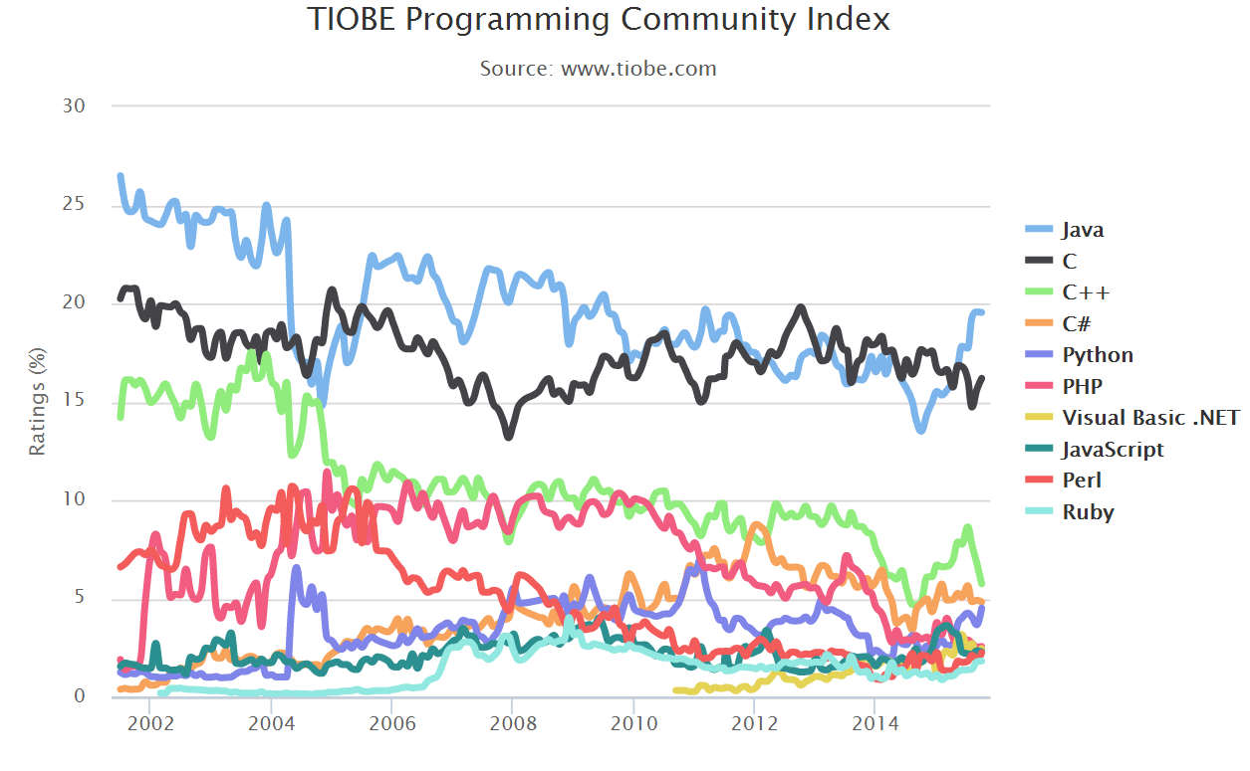
Should I learn C?
GitHub top 10
IEEESpectrum - ranked number 2

Slide 6
Basic Syntax
Statements should end with a semicolon, except for scopes (more on scopes later)
a = 123;
Arithmetic and bitwise operators are the same as in Python, with two exceptions:
** does not exist in C
++ – Unary increment operator, has two versions:
Prefix: Increments the variable and then executes the rest of statement
y = ++x; /* x += 1; y = x; */
Postfix: Executes the statement and then increments
y = x++; /* y = x; x += 1; */

Slide 7
Basic Syntax
Comments
/* */ – Denotes a multi-line comment
// – Means that the rest of the line should be ignored (C99 and newer only – do not use)
Literals (constant values) are similar to Python
One notable exception is '', which is used for single characters in C

Slide 8
Variables
Statically-typed, a few of the built-in types are:
int – an integer
float – a floating-point number
char – ASCII character (actually just a smaller integer)
Most types are signed by default, but also have an unsigned version
Can only be defined in beginning of blocks
Syntax:
<type> <name> [= <init_value>];
i.e unsigned int mynum;
float real1, real2 = 12.3;

Slide 9
Casting
Casts are used to convert the value from its original type to a new one:
printf(“%d”, (int) 12.23);
Casts are sometimes done automatically by the compiler (this is called implicit casting)

Slide 10
Conditions
C (before C99) doesn’t have a Boolean type
Instead, 0 is considered false, anything else is true (1 is used by default)
Relational operators:
==, !=
>, <, >=, <=
Logical operators:
&&, ||, !
C uses lazy evaluation when && and || are used

Slide 11
Control Structures
if statements – execute statement only if condition is true:
if (<condition>) <statement>;
Optionally, you can add else (and else if) statements:
else if (<condition>) <statement>;
else <statement>;
if (i < 5) printf(“Too small”);
else if (i == 5) printf(“Perfect!”);
else printf(“Too big”);

Slide 12
Control Structures
C provides syntactic sugar for conditional assignment:
char c = i == 5 ? ‘V’ : ‘X’;
This is equivalent to:
char c;
if (i == 5)
c = ‘V’;
else
c = ‘X’;

Slide 13
Control Structures
Loops:
while – Keep executing statement as long as condition is true:
while (<condition>) <statement>;
while (!done)
done = do_something();
do-while – Like while, except runs statement at least once:
do <statement> while (<condition>);
do
c = getchar();
while(c != ‘1’);

Slide 14
Control Structures
for – Special loop for iterating over collections (mostly)
for (<init>; <condition>; <step>) <statement>;
First runs init, then checks condition, then executes statement, and lastly executes step. Then it’s back to checking condition all over again, until condition is false (zero)
for (int i = 0; i < 5; ++i)
printf(“%d”, i);

Slide 15
Control Structures
break – Immediately leaves loop (in for loops, doesn’t run step statement)
continue – Jumps to the beginning of the loop (in for loops, does run step statement)

Slide 16
Control Structures
switch – Used to compare a variable against a hard-coded list of numeral or character values
Syntactic sugaring of if – else if – else if – else…
Fall-through behavior – Unless a break statement is executed, code execution will continue ignoring new case statements
A default case is the equivalent of else
switch (myvar) {
case 0:
printf(“zero”);
// Fall-through
case ‘A’:
printf(“A”);
break;
default:
printf(“something else”);
}

Slide 17
Blocks
Curly-brackets are used to denote a group of statements instead of a single one
while (i < 5) {
printf(“%d ”, i);
i++;
}
Also called a block
These groups are also used to define the lifetime of variables (called scope). More on this later

Slide 18
Arrays
Arrays are fixed-size collections of variables of the same type
Can be initialized to hold specific values
int a[5] = { 1, 2, 3, 4, 5 };
Elements missing from the list will be init’ed to zero
int zeroes[5] = { 0 };
To reference a specific element, use []
C arrays are zero-based, so this will set the third element:
a[2] = 3;

Slide 19
Preprocessor
#include
Simply copies the content of the specified file into the current file
Two flavors:
#include <file> - Looks for the file in the include directories specified to the compiler
#include “file” – Looks for the file in the current directory, and if that fails reverts to include directories
#define <name> <value>
Replaces occurrences of name with value
Enables more advanced uses which we will not cover

Slide 20
main()
The entry point of the program
Must return an int
0 usually means success, other values are error codes
Optionally, can receive an array of strings containing the command-line used to run the program
int main(int argc, char *argv[])

Slide 21
Input and Output
Many functions provided by the standard library in stdio.h
Output is usually done using printf:
printf(“My name is %s”, “Moshe”);
For input:
getchar() retrieves a single character from standard input
char c = getchar();
scanf() is the input equivalent of printf
scanf(“%d”, &num);
Don’t forget the &! More about this later

Slide 22
Demo Time

Slide 23


